Slide 1

Visualization and Analysis – Date:
Group Id: A175 Name of Student Presenting:

Slide 2
PART 1: VISUALISATION

Slide 3
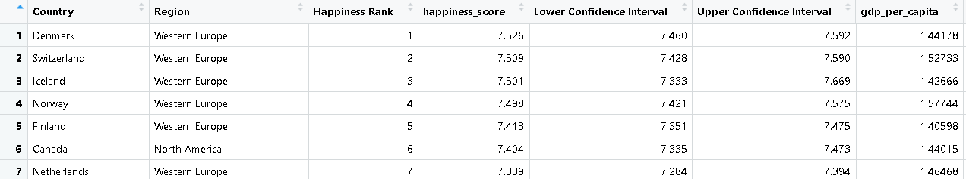
We are using the dataset DS007 (2016.csv) to answer our Research Question “Is there a correlation between Happiness Score and GDP per Capita?”
The dataset has 157 rows and the variables we use are happiness_score (dependent variable) and gdp_per_capita (independent variable).

Slide 4
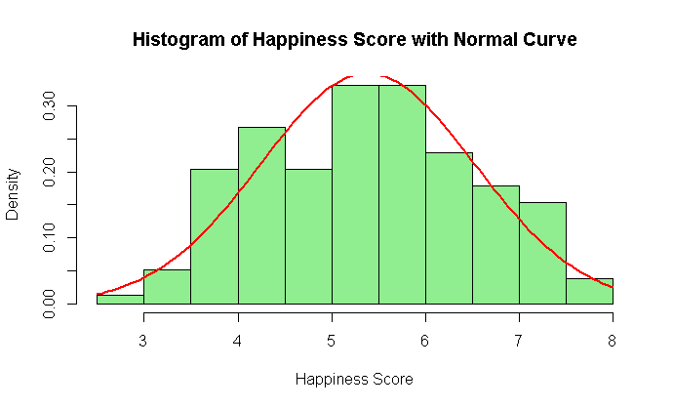
4
Histogram

Slide 5
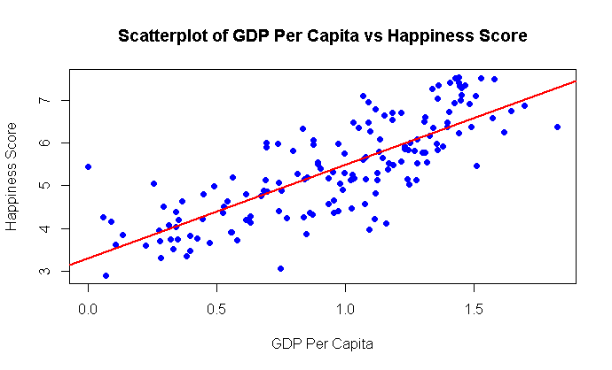
5
Scatter Plot

Slide 6
PART 2: ANALYSIS

Slide 7
Here is a Histogram showing the frequencies of our dependent variable to include the normal curve overlay.
Our RQ asks about Correlation
The red normal curve overlay follows the contours of the underlying data, so for our analysis we will use a parametric test for correlation: Pearson’s
7

Slide 8

8
R Script
Notes:
8

Slide 9
Results
9
PRE 7COM1079-2022 Student Group No: ?????
9
Aspect | Interpretation
Test Statistic (t) | t=16.059t = 16.059t=16.059: Strong evidence for correlation.
P-value | p<2.2×10−16p < 2.2 \times 10^{-16}p<2.2×10−16: Statistically significant.
Correlation Coefficient (r) | r=0.790322r = 0.790322r=0.790322: Strong positive correlation.
Confidence Interval | 0.7230.7230.723 to 0.8430.8430.843: Likely range of the true correlation.
Null Hypothesis | Rejected.
Alternative Hypothesis | Accepted
Conclusion | Higher GDP per capita is strongly associated with higher happiness.
Notes:
9

